Slide 1
Life Members of San Antonio Richard Wiggins, Chair IEEE Central Texas Section Spring Meeting January 21, 2017 San Marcus, TX

Slide 2
Agenda
Officers
Review of last year
Plans for this year
Issues

Slide 3
2017 Election of Officers
Name Position email
Richard Wiggins Chair Wiggins@IEEE.org
James Brakefield Vice Chair Jim.Brakefield@IEEE.org
Scott Atkinson Treasurer s.atkinson@IEEE.org
John Lyons Secretary jlyons@IEEE.org

Slide 4
Review of 2016
January Planning Meeting (ExCom)
January IEEE USA (Karen Pedersen, President-Elect)
February Trip Report ( IEEE LM European Milestone Tour)
March NASA New Horizons Mission (Scott Weidner)
April DoSeum Tour: New Children’s Science Museum
May Solar Power Innovation ( CoWatt, Bill Tolhurst)
June FPGA Technology Update ( James Brakefield )
July Programming the Codebug ( Tom O’Brien)
August Ft Sam Houston Museum ( Bill Manchester )
September Robotics and Automation ( Michael Rigney, SwRI)

Slide 5
2016 Program Review
October NASA SOFIA Project ( Scott Atkinson)
November Joint Appreciation Dinner with Com/SP
December Data Science at Work ( Columbia, Chris Wiggins)

Slide 6
2016 Summary
14 Meetings
7 Technical
2 Administrative
2 Community / Social
Average attendance: 12-20

Slide 7
Chapter Plans - Projects
Survey membership for meeting preferences (surveymonkey.com and vTools)
Participate in Witte “Build It” event –an Engineers Week activity
Upgrade webpage –
Use evite to send notices, get reservations
Add calendar update capability
Judging at Science Fair and Junior Academy of Sciences
Support and judging for SA BEST robotics competition
Engineering Student Project Show (St. Mary's)
Develop an “Inexpensive Microcomputer” program /tutorial for middle/high school students

Slide 8
Chapter Plans - Programs
In addition to monthly meetings:
Planning lunches with ExCom as needed
Explore joint meeting opportunities
Explore Engineers Week activities
Support Section planning meetings
Add community Projects
Member Activities
Notes:
Notes:

Slide 9
Chapter Plans - Meetings
January: Sports Technology
February: David Monroe: New SA Museum
March: TBD
Future Topics (Witte Museum, Build it Day, SwRI Visit, and Year-end Social)

Slide 10
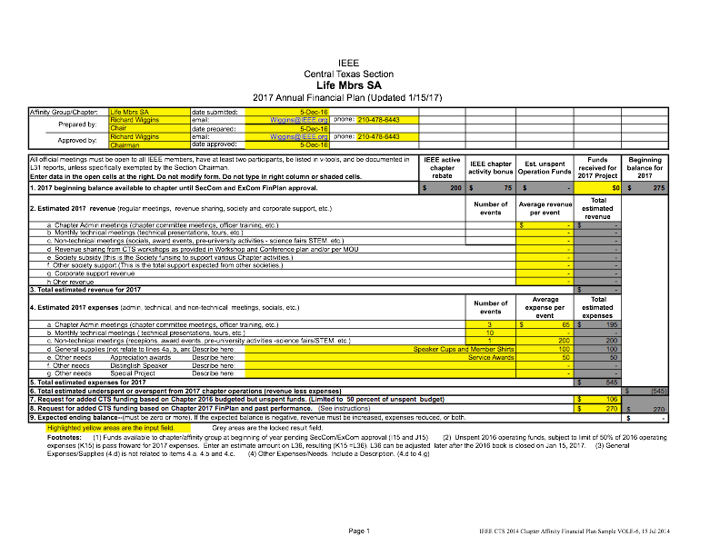

Slide 11
Chapter Issues
Strengths
Members have active interest in project activities
Monthly Schedule (mix of Technical, Social, General Interest)
Members are using vTools to register
Weaknesses
Involve more Life Members
Opportunities
Work with other groups (DoSeum, SA STEM Museum, Witte, Science Fair, SA BEST, FIRST Robotics, School Districts)
Mentoring, service related activities
Threats
Facilities
Attendance
Notes:
Notes:

Slide 12
QUESTIONS??? Thanks
Notes:
If you’d like to learn more about electronic services, you’ll want to attend the session on the Electronic Services being presented this afternoon by Christian Borgert (BORE-GERT) and Chip Dawson. If you miss this afternoon’s session, you can see it tomorrow morning.
Now I’d like to answer your questions about newsletters and electronic services . . .
(After Q&A)
I’m sorry we don’t have time to answer all of your questions, but we have an abundance of expertise with us this weekend, and much of it is in the Computer Lab upstairs. Stop by and get more information anytime.

